Slide 1
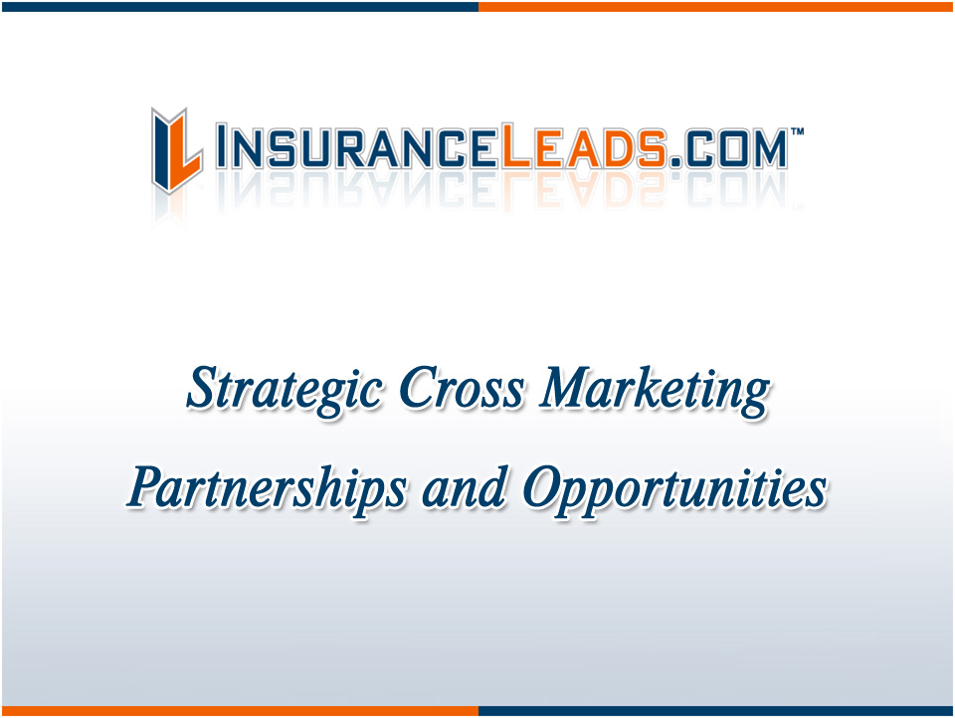

Slide 2

Today’s Marketplace
As consumers become more internet savvy, they are no longer content with insurance rates offered by their local insurance agency.

Slide 3
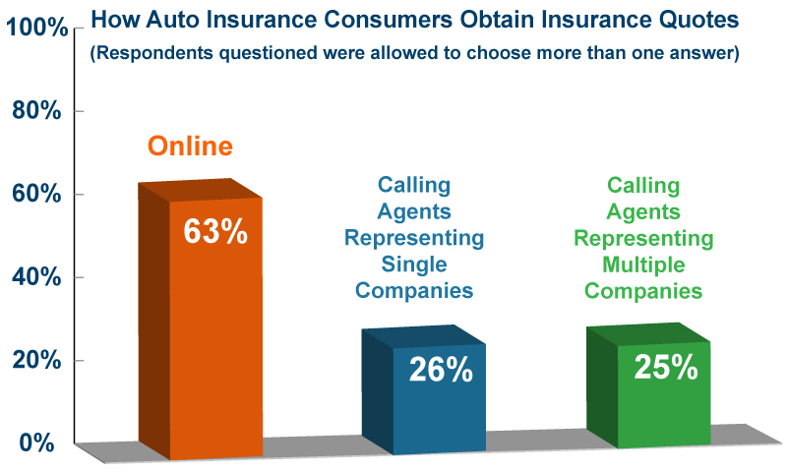
Online Shopping is Growing

Slide 4

Internet Convenience
The internet allows consumers the convenience of comparing quotes from a number of insurance agents and carriers in minutes, just by filling out one intuitive online questionnaire.

Slide 5
Benefits of Online Lead Generation
Online lead generation is playing an increasingly important role for businesses
Agents are most likely to convert online leads through email and online transactions
Premium lead generation methods deliver an ROI, but levels vary based on the individual agent’s ability to create a rapport with the prospect, and ultimately sell the product
All the benefits of a multi-million dollar lead generation campaign, without having to incur the costs

Slide 6
Potential Customers Online
The number of companies who say that online lead generation budgets have gone up in the last year has increased from 59% last year to 65% this year.
This compares to 31% of respondents who say that offline lead generation budgets have increased.
A 2009 study by Internet marketing research company “comScore” indicates consumers requested more than 32 million auto insurance quotes via the Internet and bought about 2.4 million auto insurance policies in 2008.

Slide 7

Internet Leads in Your Marketing Strategy
With such a massive flight of consumers to the internet to shop for insurance, internet insurance leads must be a major feature in your marketing portfolio.

Slide 8
Strategic Cross Marketing

Slide 9

Strategic Partner Program
Marketing is the process of developing and communicating value to your prospects and customers
In today's very competitive marketplace a strategy that insures a consistent approach to offering your product or service in a way that will outsell the competition is critical
InsuranceLeads.com is one of the largest Insurance lead aggregators in the U.S. today
IL has access to over 100,000 agents / brokers in the U.S.

Slide 10
Strategic Partner Evaluation
Market Profile: Size, competitors, stage of growth
Customer Segments: Do we have similar groups of prospects with similar wants & needs?
Competitive Analysis: Strengths, weaknesses, opportunities and threats in the landscape
Positioning Strategy: How to position the offerings
Value Proposition: The value each partner delivers

Slide 11
Strategic Partner Benefits
Access to distribution channels and national market presence
Access to technology, products and intellectual properties
Access to marketing capital
New markets for services/products, or new products for customers
Increase in brand awareness through channels provided
Decrease marketing costs by leveraging a number of our assets

Slide 12
Multiple Opportunities for Growth

Slide 13

Co-Branding
Build a program that will allow both brands to be introduced in each organizations’ database of agents, brokers and insurance carriers

Slide 14

Link Exchange
Create a link-exchange which allows for increased traffic levels to each company’s websites.

Slide 15
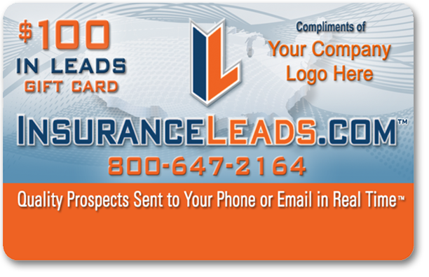
Co-Branded Reward Programs
Build a program that allows both brands to be introduced in each organizations’ database of agents, brokers and insurance carriers

Slide 16
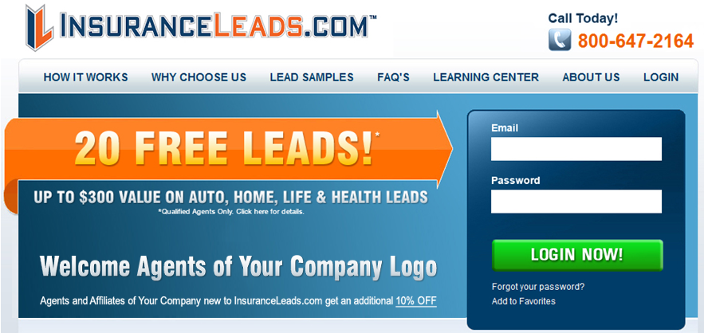
Co-Branded Landing Pages
Design co-branded landing pages for online recruitment of agents / brokers.

Slide 17

Cross Marketing & Advertising Packages
Potentially construct both online and offline cross-marketing and advertising packages that will create the ability to generate monthly recurring revenue streams

Slide 18
Why Choose InsuranceLeads.com ?

Slide 19
Our Internet Leads
Highest Quality Leads in the Industry
Multi-Layer Quality Control
Competitive Pricing
Volume Discounts
24/7 Online Leads Management Interface
Largest Selection of Lead Types and Filters
Sophisticated Technology
Choice of Delivery Methods
Consistent High Leads Volume
Hot Transfers of Interested Prospects Verified by Live Operators

Slide 20
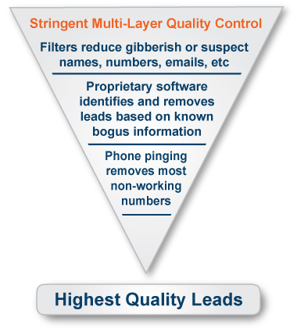
Qualified Real Time Internet Leads
InsuranceLeads.com invests millions of dollars into generating the very best qualified real time internet insurance leads on the web.
To us, all leads are considered suspect before they become a real prospect.

Slide 21
Lead Types
We provide internet leads in just about every line of insurance
Automobile
Home
Renters
Life
Business P&C
Business Benefits
Annuity
Health
Disability
Cancer
Final Expense
Long Term Care

Slide 22

How We Generate Traffic and Leads
InsuranceLeads.com
The Most Visible Sign On the
Information Super Highway
Thousands of high ranking sites maintaining top positions generate and aggregate tens of thousands of high quality leads daily.
The largest network of in-house search engine marketing experts.
Large network of hundreds of top affiliate partners.
We spend millions of dollars monthly so you don’t have to.

Slide 23
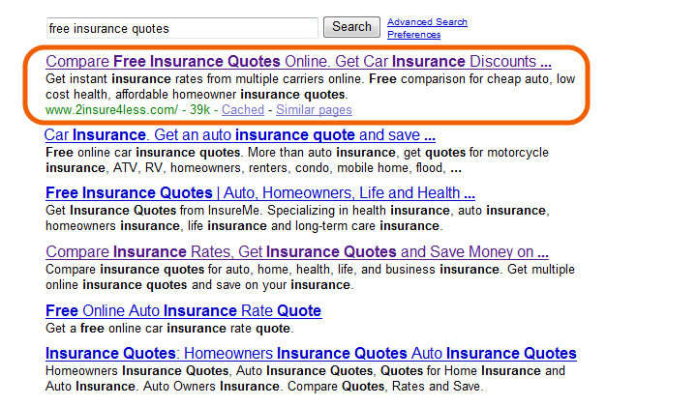
Top Ranking SEO and SEM
As a leader in the insurance leads generation business we have high rankings on every search engine for thousands of keywords. This leads insurance consumers directly to our insurance quote websites and affiliate partners across the country.

Slide 24
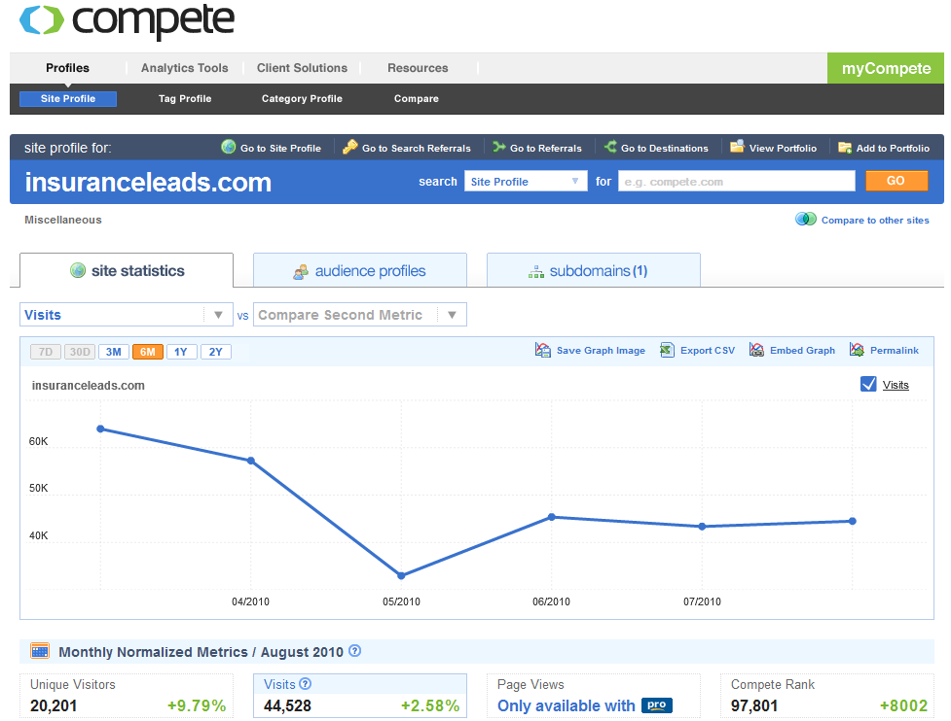
InsuranceLeads.com Traffic Levels

Slide 25
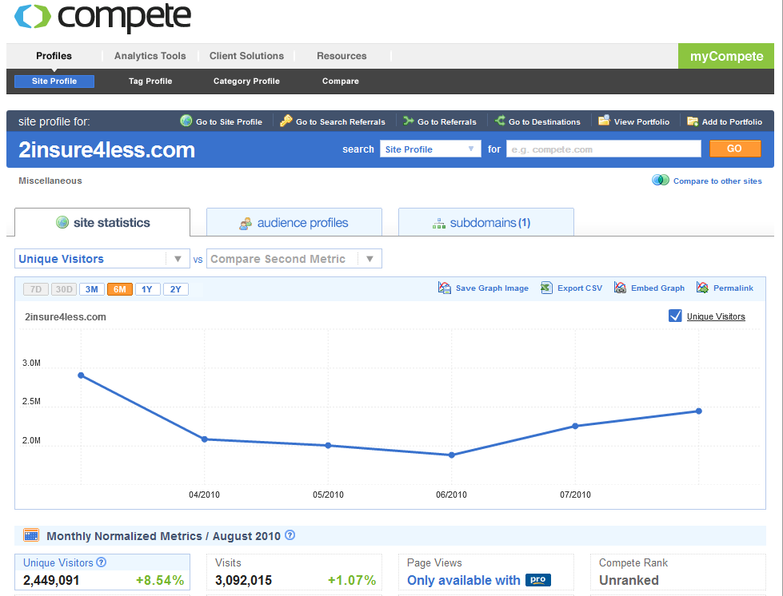
2Insure4Less.com Traffic Levels

Slide 26
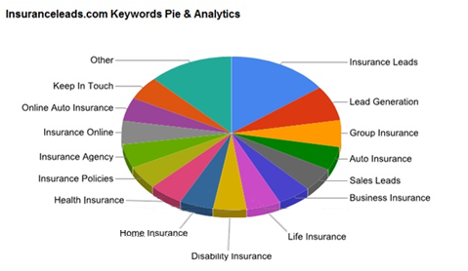
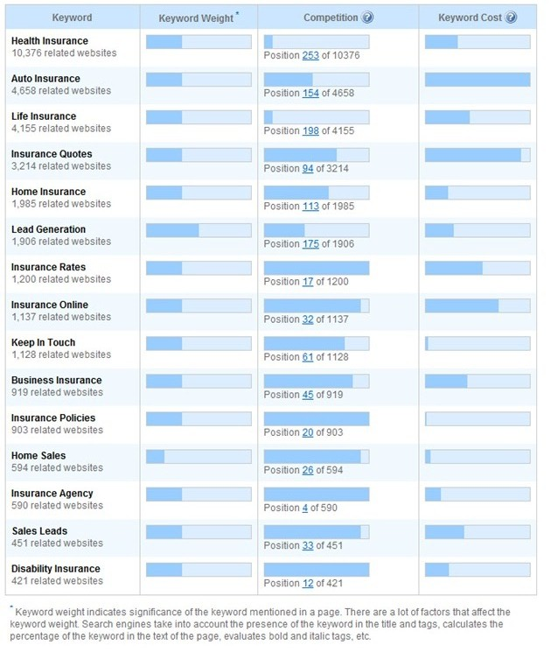
Keywords Analytic Breakdown

Slide 27
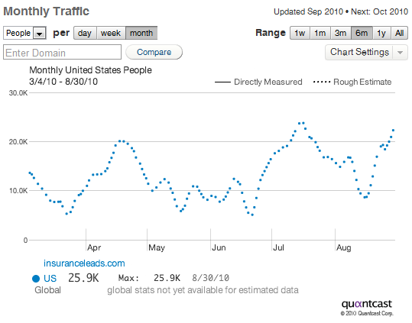
Monthly Traffic Breakdown

Slide 28
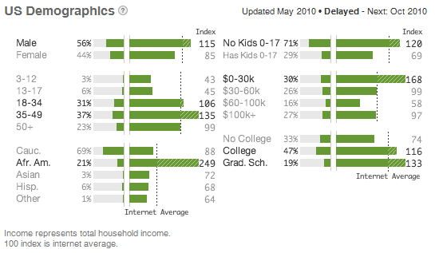
US Demographic Breakdown

Slide 29

Maximize ROI and Increase Revenue
Ultimately the measure of success for any Online Lead Generation campaign is ROI and very simply, the higher the revenue potential from a converted customer the more opportunities there are for lead generation.
If you generate 10,000 leads from a campaign and you only require 100 leads to convert into a sale to make the campaign a success then you are far more likely to have a successful campaign than if you need 500 leads to convert into business.

Slide 30


Join Our Growing Network
6400 Laurel Canyon Blvd, Suite 460
North Hollywood, California 91606
^{Phone: 800.647.2164}
^{Fax: 800.647.2142}
Web: http://www.insuranceleads.com

Slide 31


