Slide 1


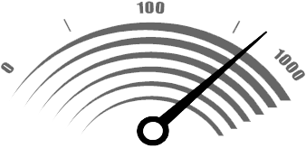

Marketing For a Brave New World!
Sponsored by
Radix Promotions and Marketing
TM

Slide 2
Introduction
Who am I?
Why do I think I know what I am speaking about?

Slide 3
Marketing of Yesterday
Dark-haired step child of the organization
Interruptive Campaigns
No Accountability
Metrics?

Slide 4
Marketing of Today
Responsible for MORE with LESS
Accountable for revenue contribution
Metrics!
Inbound Marketing / Demand Generation

Slide 5
Inbound Marketing Vs. Outbound Marketing
“Audiences everywhere are tough. They don’t have time to be bored or brow beaten by orthodox, old fashioned advertising.
We need to stop interrupting what people are interested in & be what people are interested in.”
CRAIG DAVIS
CHIEF CREATIVE OFFICER, WORLDWIDE
J. WALTER THOMPSON (WORLD’S 4TH LARGEST AD AGENCY)
Notes:
How do we become what people are wanting

Slide 6
Inbound Marketing Vs. Outbound Marketing
Fact:
The internet has fundamentally changed the way people find, discover, share, shop, & connect.
Notes:
Interuptive tactics do not work. Educated research purchase decisions

Slide 7
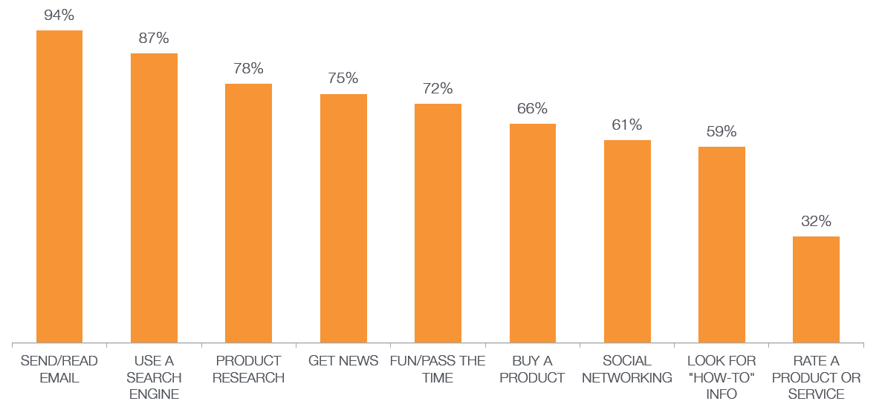
Inbound Marketing Vs. Outbound Marketing
The things we used to do offline,
we now do online.
SOURCE: PEW RESEARCH CENTER, MAY 2010

Slide 8
Inbound Marketing Vs. Outbound Marketing
Fact:
Marketers are shifting their budgets away form “interruption” advertising

Slide 9
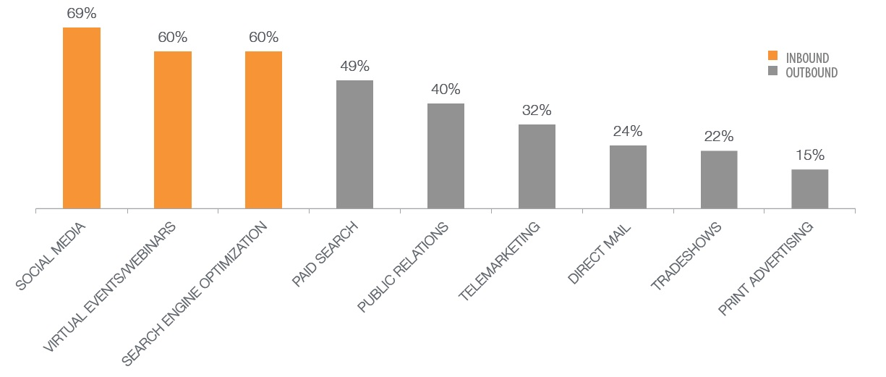
Inbound Marketing Vs. Outbound Marketing
B2B marketers are shifting their budgets toward inbound marketing
SOURCE: MARKETINGSHERPA, OCTOBER 2010
Notes:
Content marketing

Slide 10
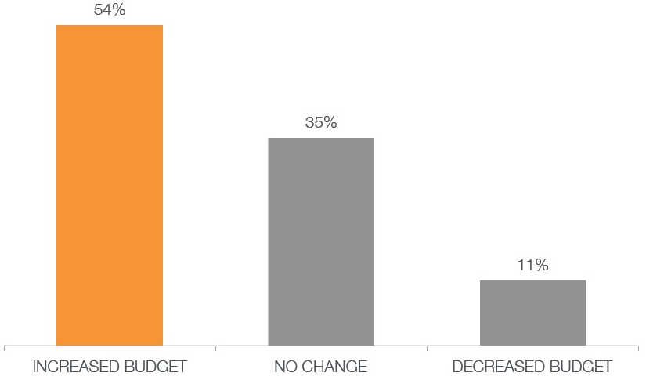
Inbound Marketing Vs. Outbound Marketing
More than half of marketers increased their
inbound marketing budget in 2011
SOURCE: HUBSPOT STATE OF INBOUND MARKETING REPORT, 2011

Slide 11
Inbound Marketing Vs. Outbound Marketing
Fact:
Inbound marketing is a lot more cost effective than traditional, outbound marketing

Slide 12
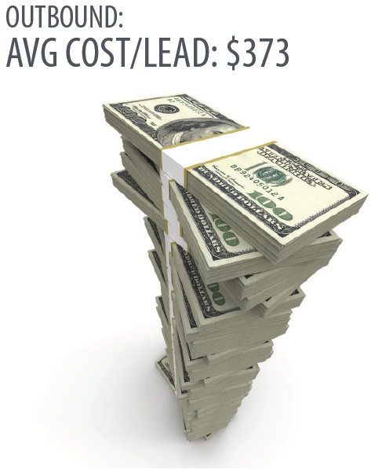
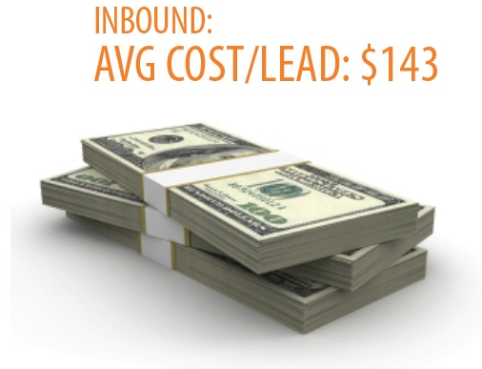
Inbound Marketing Vs. Outbound Marketing
Inbound marketing costs 62% less per
lead than traditional, outbound marketing
SOURCE: HUBSPOT, 2011

Slide 13
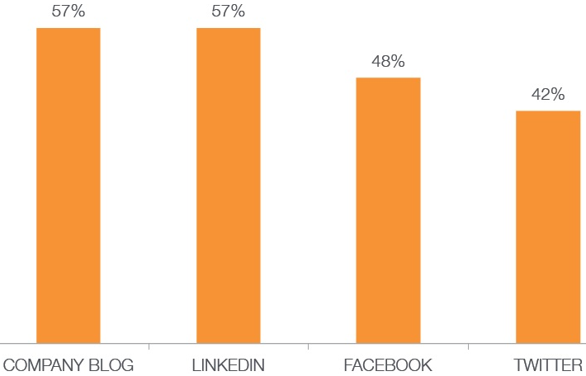
Inbound Marketing Vs. Outbound Marketing
Inbound marketing tactics don’t just generate leads.
They generate revenue.
SOURCE: HUBSPOT STATE OF INBOUND MARKETING REPORT, 2011
Notes:
Marketing responsibility

Slide 14
Inbound Marketing Vs. Outbound Marketing
The Bottom Line:
Go inbound or go home!!!

Slide 15
Demand Generation & Marketing Automation
So Now What????!!!!
Notes:
Ad agencies obsolete w/o demand generation

Slide 16
Demand Generation & Marketing Automation
What is Demand Generation?
Demand Generation is the focus of targeted marketing programs to drive awareness and interest in a company's products and/or services.
Commonly used in business to business, business to government, or longer sales cycle business to consumer sales cycles, demand generation involves multiple areas of marketing and is really the marriage of marketing programs coupled with a structured sales process.
Notes:
software

Slide 17
Demand Generation & Marketing Automation
Three key elements a Demand Generation approach: 1. Building a holistic, integrated set of buyer nurturing programs that enable marketing to operate at the center of—and lead—the customer acquisition, adoption and renewal processes. 2. Leveraging Marketing Automation as the core infrastructure to power Demand Generation programs. 3. Creating a set of business processes to integrate the marketing and sales teams, closely track and optimize marketing spend and capitalize on a company's existing success.

Slide 18
Demand Generation & Marketing Automation
Data Points
Only 2-5% of companies today are using marketing automation (Laura Ramos, Forrester)
89% of companies struggle with automating marketing functions (Aberdeen)
Today, only 27% of all closed sales come from leads
generated by marketing (Sirius Research)

Slide 19


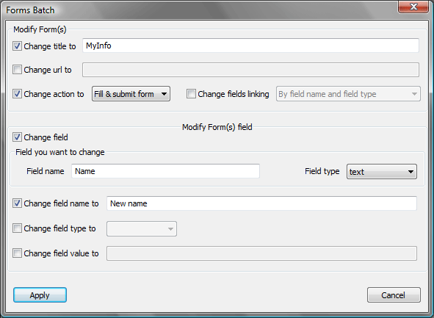





Demand Generation & Marketing Automation
Benefits of Using Marketing Automation
OLD WAY - ESP, Google Analytics, etc…
Unknown Actions & readiness
Prospect
Contact form completed
No Personalization
No Engagement
NEW WAY - Marketing Automation
Contact form is mapped & added directly into your lead database
Name, email, phone
gives us details for 1:1 communications
We know when she’s ready! Faster/more tailored follow-up
Prospect

Slide 20

Demand Generation & Marketing Automation
Before Marketing Automation
Annual quality leads marketing sends to sales: 1,200
Sales based on 16% conversion rate (Aberdeen study): 192
Lifetime revenue per deal: $4,800
Lifetime revenue generated: $921,600
Marketing costs: $300,000
Marketing Net profit: $621,000
Marketing Cost-per-sale $1,562
Marketing ROI: 107%

Slide 21
Demand Generation & Marketing Automation
After Marketing Automation
Annual quality leads marketing sends to sales: 1,800
50% Higher
Leads sent to sales that were closed -16% : 288 (Aberdeen study)
+ 92 Opportunities
Lifetime Revenue generated: $1,382,400 (Immediately)

Slide 22




Is Demand Generation & Marketing Automation Right for Your Business?
Are you sending emails as part of your marketing strategy?
Is it valuable to identify who is on your website and/or interacting with emails and content?
Do you need to hand off leads to sales as soon as they reach a certain threshold of ‘readiness’?
Marketing Automation can help with automated email campaigns, granular visitor tracking, lead scoring, lead nurturing, alerts, etc.

Slide 23



Benefits by Business Type
B2B
B2C
E-Commerce
Manages complex sales cycles
Personalizes communications
Efficient
Elevate sales ready leads
Loyalty programs
Sweepstakes
Promotions and sales based on site usage
Profiling / Demographic insight
Tracks social conversation related to the brand
Cart abandonment campaigns
Promotions and sales based on purchase history
Customized e-coupons
Seasonal messages

Slide 24
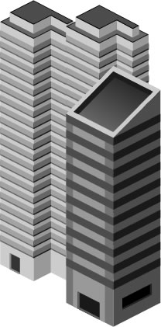


Benefits for Companies of all Sizes
Streamlines communications
Centralizes lead management
Individualizes conversations
Promotes lead cycle management
Large Enterprise
Small / Medium Business
Offers good balance of personalized
communication
Scales lead nurturing
Efficient follow-up to qualified leads
Easy to use interface
Quickly measures qualified prospects
Replaces blind cold-calling with calls to qualified leads
Helps you do more with less!
So-Ho

Slide 25

Benefits for Your Business
How does Marketing Automation benefit you?
Develop and qualify more opportunities from your database
Have ‘e-conversations’ using relevant collateral as opposed to one-off emails
Hand off the most qualified leads to sales at the height of engagement
Save time and stretch your budget with automated processes

Slide 26
Final Thoughts
By not spending more on marketing, but rather reallocating to increased digital presence, content, and lead nurturing, you are able to increase revenue, profits and lower cost-per lead.
Ultimately this leads to 5 times greater Return on Marketing spending for your company.

Slide 27
Q & A
?

Slide 28
Thank You!!

Slide 29

Marketing For a Brave New World!
Sponsored by
Radix Promotions and Marketing
TM

